Slide 1
Understanding and Solving Java Memory Problems
COURSE OVERVIEW

Slide 2
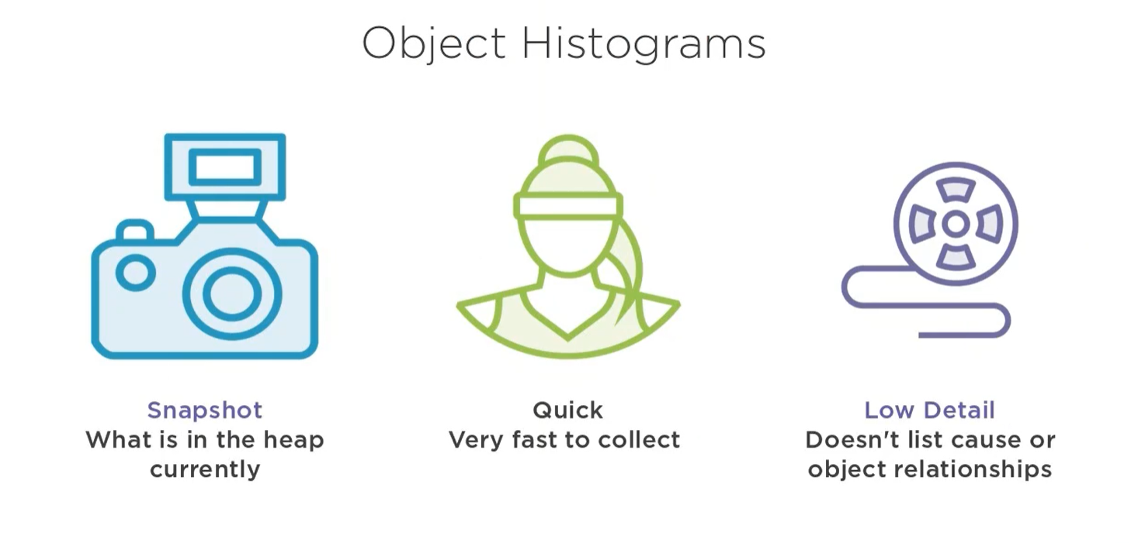

Slide 3
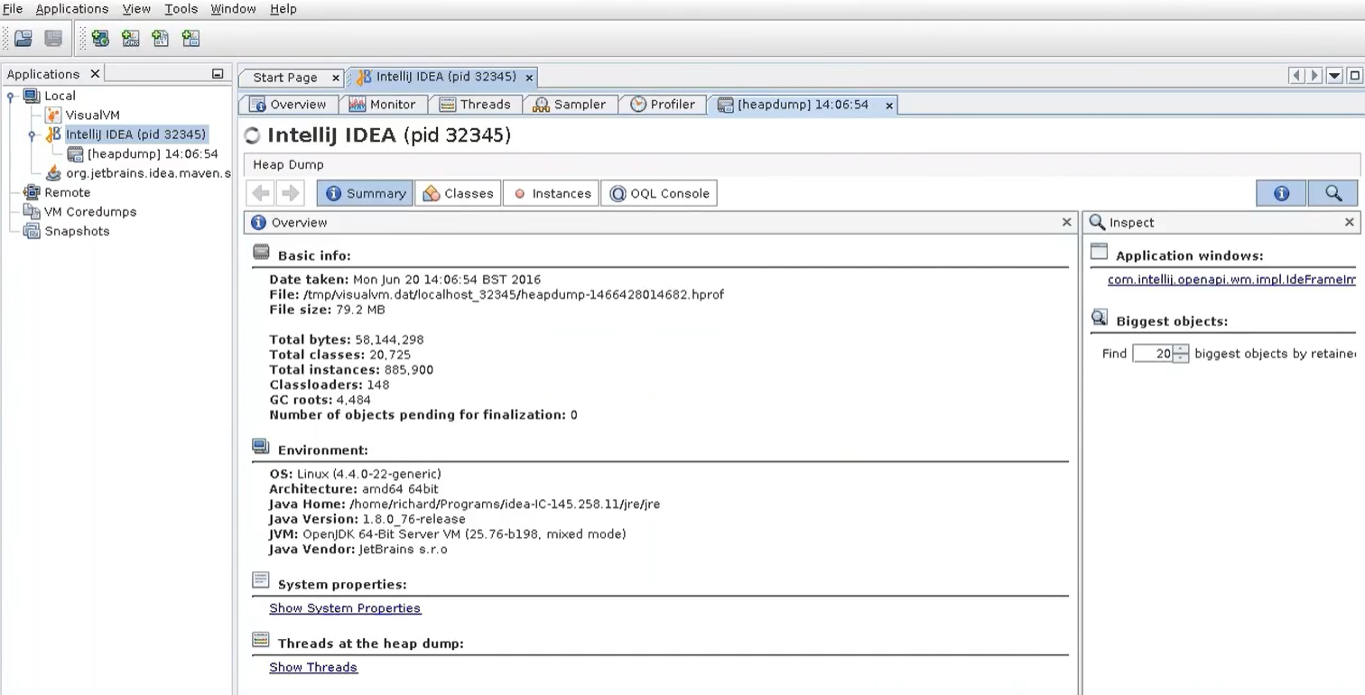

Slide 4
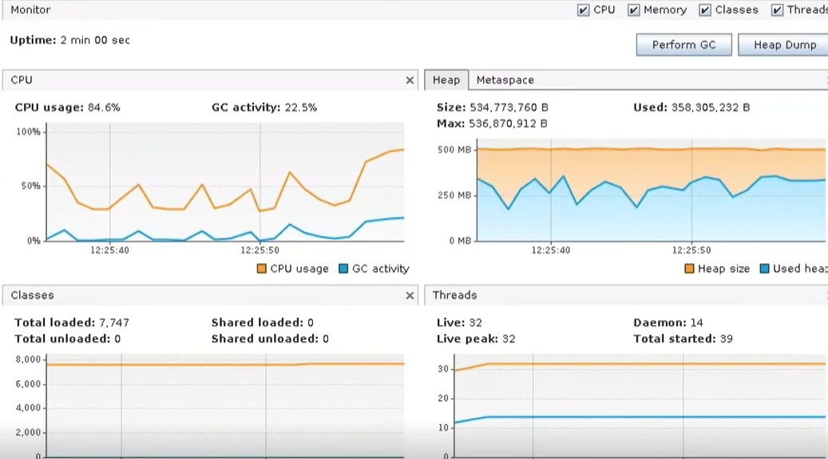

Slide 5
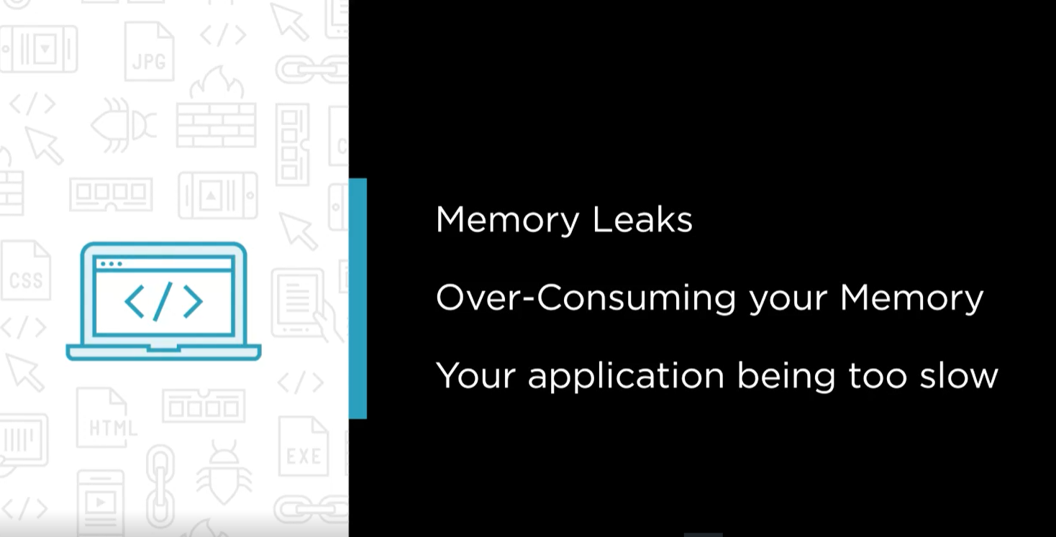

Slide 6
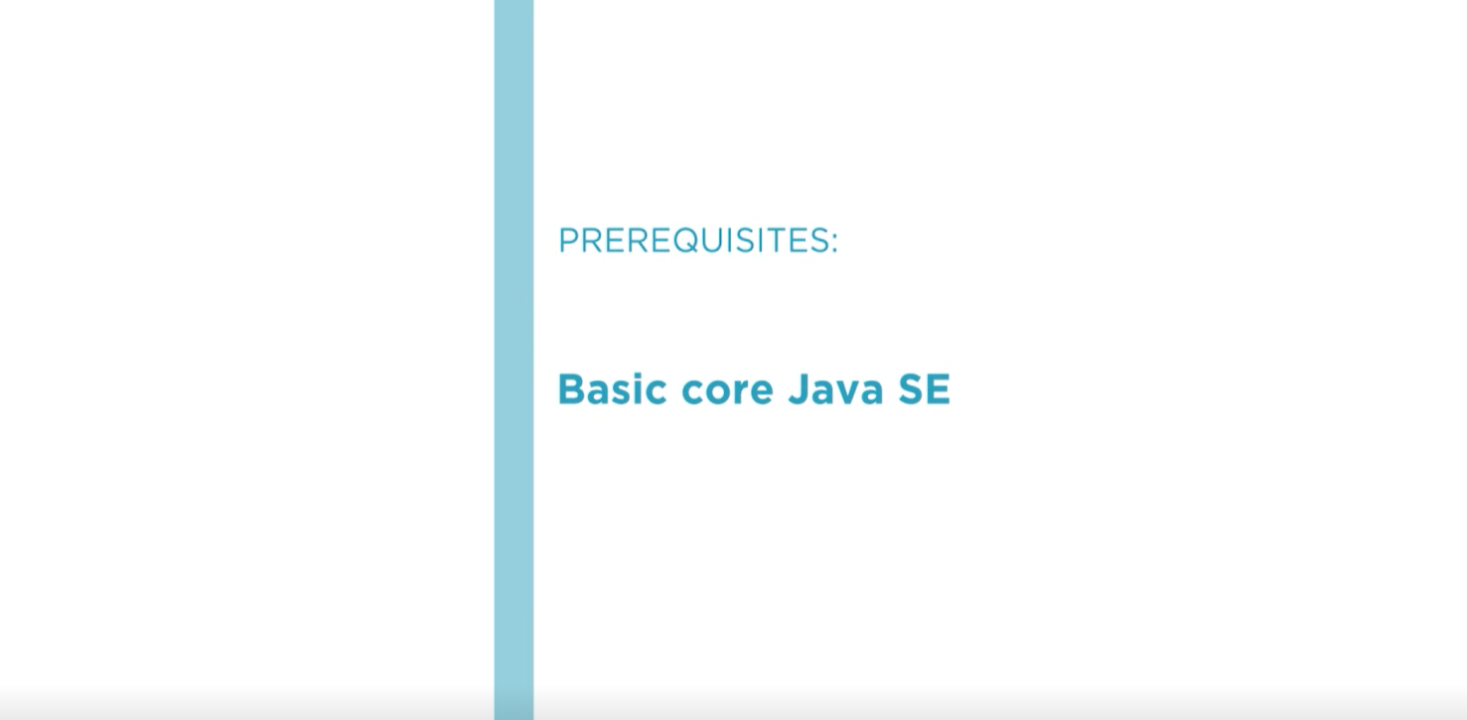
https://www.oracle.com/java/technologies/javase/javase8-archive-downloads.html

